Slide 1
Exploring Causes of Tennessee’s Rising Handgun Crime Rate
Daniel Albright, Gian Gozum, XiaoJing Zhu

Slide 2
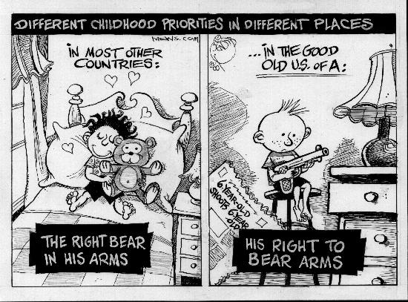
Choosing this topic
New gun laws in TN
Safer communities?

Slide 3
Gathering the Data
U.S. Census
Bureau of Economic Analysis
Reshaped
Variables: population density, personal income per capita, gun crime rate, drug violations rate, unemployment rate

Slide 4
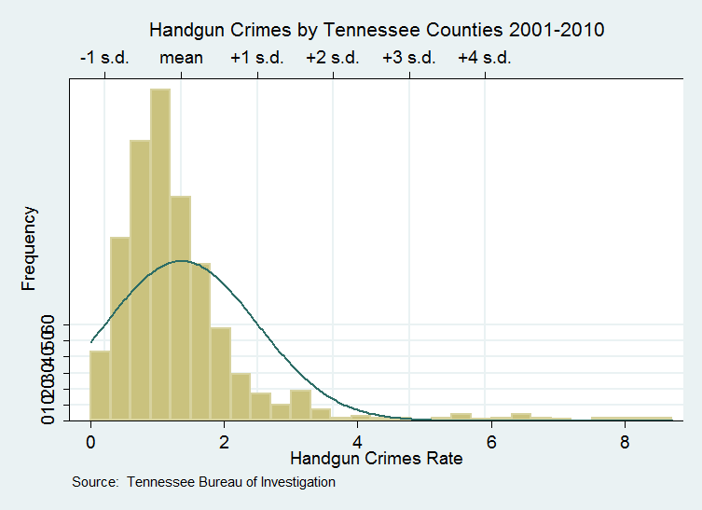

Slide 5

Empirical Specification
$Y_{it= }β_{0+β_{1}}X_{it}^{1}$+$β_{2}X_{it}^{2}$+$β_{3}X_{it}^{3}$+$β_{4}X_{it}^{4}$+$β_{5}X_{it}^{5}$ +$β_{6}X_{it}^{6}+Ɛ_{it}$
Handguncrimerate=0.8402715+0.0002575$X_{it}^{1}+0.0017581X_{it}^{2}−0.000013X_{it}^{3}$+$9.65e−07X_{it}^{4}$+$0.0700056X_{it}^{5}$ $−0.2470203X_{it}^{6}$, $R^{2}$=0.5
B1= Handgun permits, B2= Population Density, B3=Personal Income per Capita, B4= Unemployment Rate, B5= Drug Violations Rate, B6=dry

Slide 6
Econometric Issues
Handgun permit data 2008-2010
Everything else 2001-2010
Omitted: Educational attainment and poverty levels

Slide 7

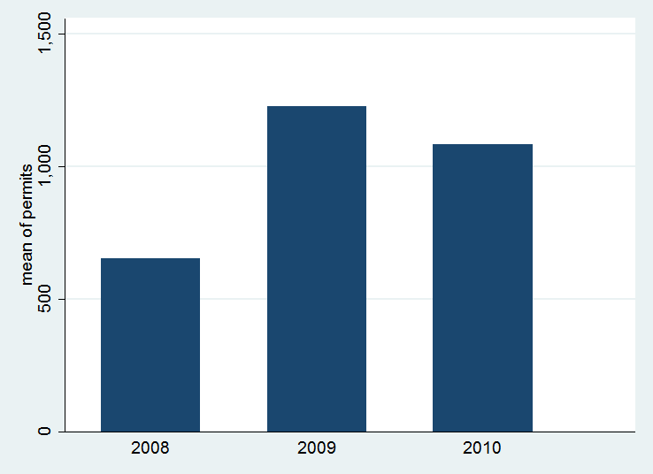
Increase in Gun Permits

Slide 8
Results

Slide 9
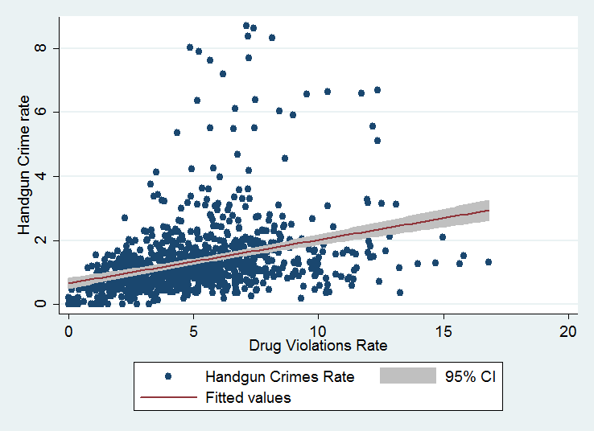
Regression with 95% CI

Slide 10
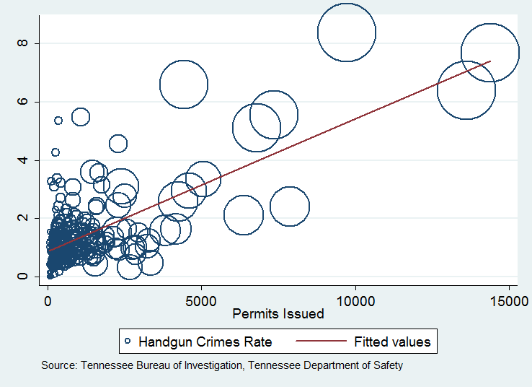
Regression with Population Size

Slide 11
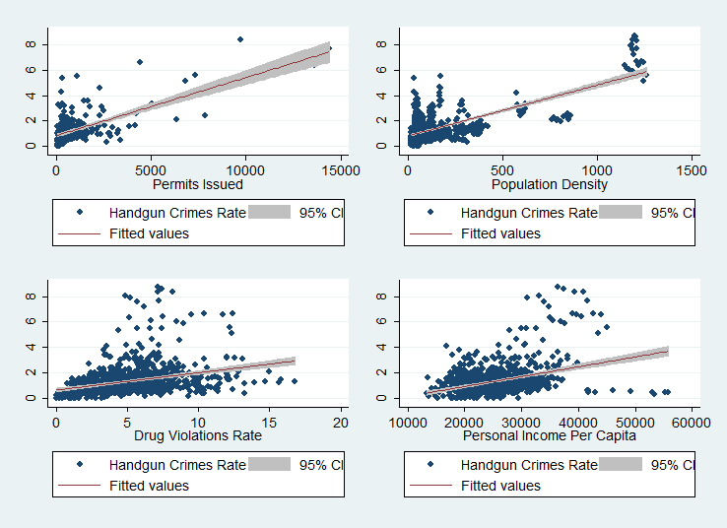
Regressions of Four Variables

Slide 12
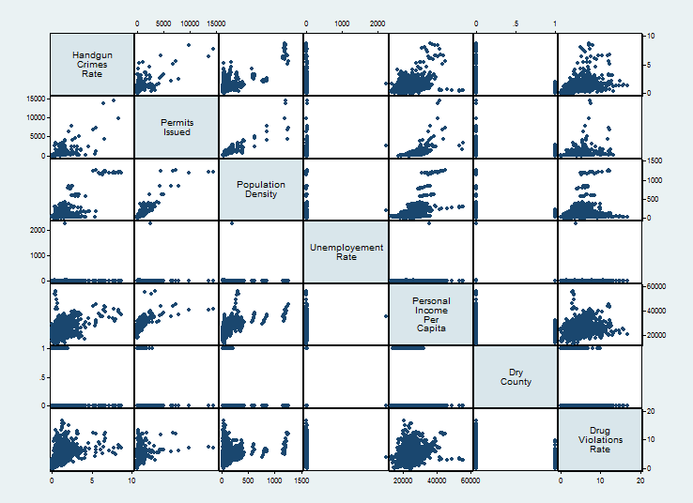
Matrix Regression

